Slide 1
Introduction to Machine Learning
CCS3102

Slide 2
This Week
Logistic Regression
Evaluation Metrics
Accuracy
Precision
Recall
F1-score
ROC Curves & AUC
PR Curves & AU-PRC
Dummy Models
Scaling Data
Standardization
Normalization
Practical Examples

Slide 3
Logistic Regression
Model
Target / Label
f(X) ~ y
~
Regression
Classification
Logistic Regression
Binary
Multiclass

Slide 4
Logistic Regression
Model
Target / Label
f(X) ~ y
~
y_{i} ∈ {0, 1}
Negative class
Positive class

Slide 5
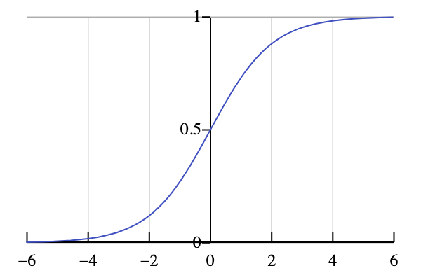
Logistic Regression
In linear regression
f(X) = X.w (-∞, ∞) ∊IR
But for logistic regression
f(X) = sigmoid(X.w) (0, 1) ∊IR
Then we apply a threshold to the outcome to get binary labels
For example >= 0.5

Slide 6
Evaluation Metrics
After training a model, we need to evaluate its performance on unseen data. This helps answer:
How well is the model generalizing?
Is it making useful predictions?
Which model is best?

Slide 7
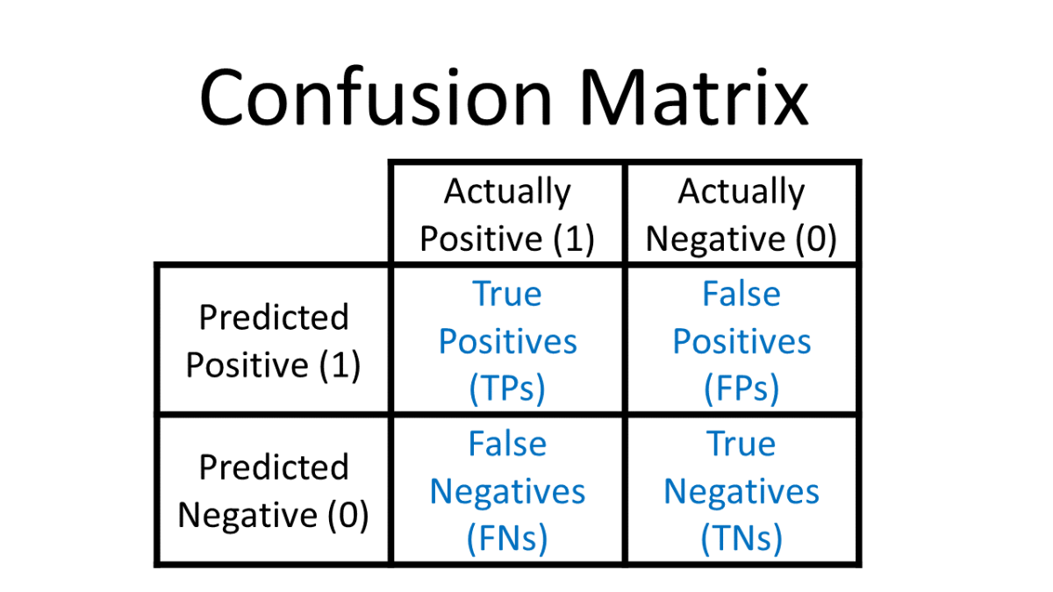
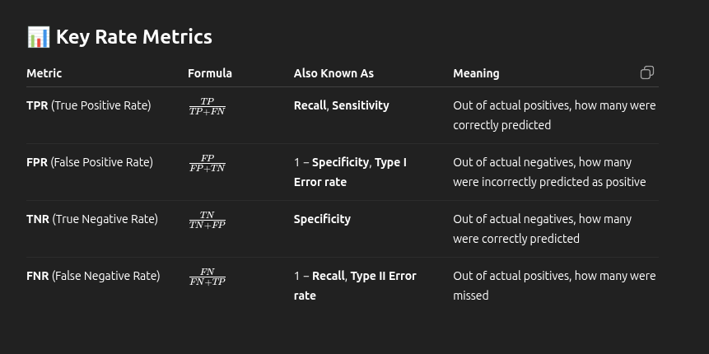
Evaluation Metrics
Confusion Matrix
What it is:
A table used to describe the performance of a classification model.
Why it’s useful:
It helps visualize errors and understand types of mistakes the model is making.

Slide 8
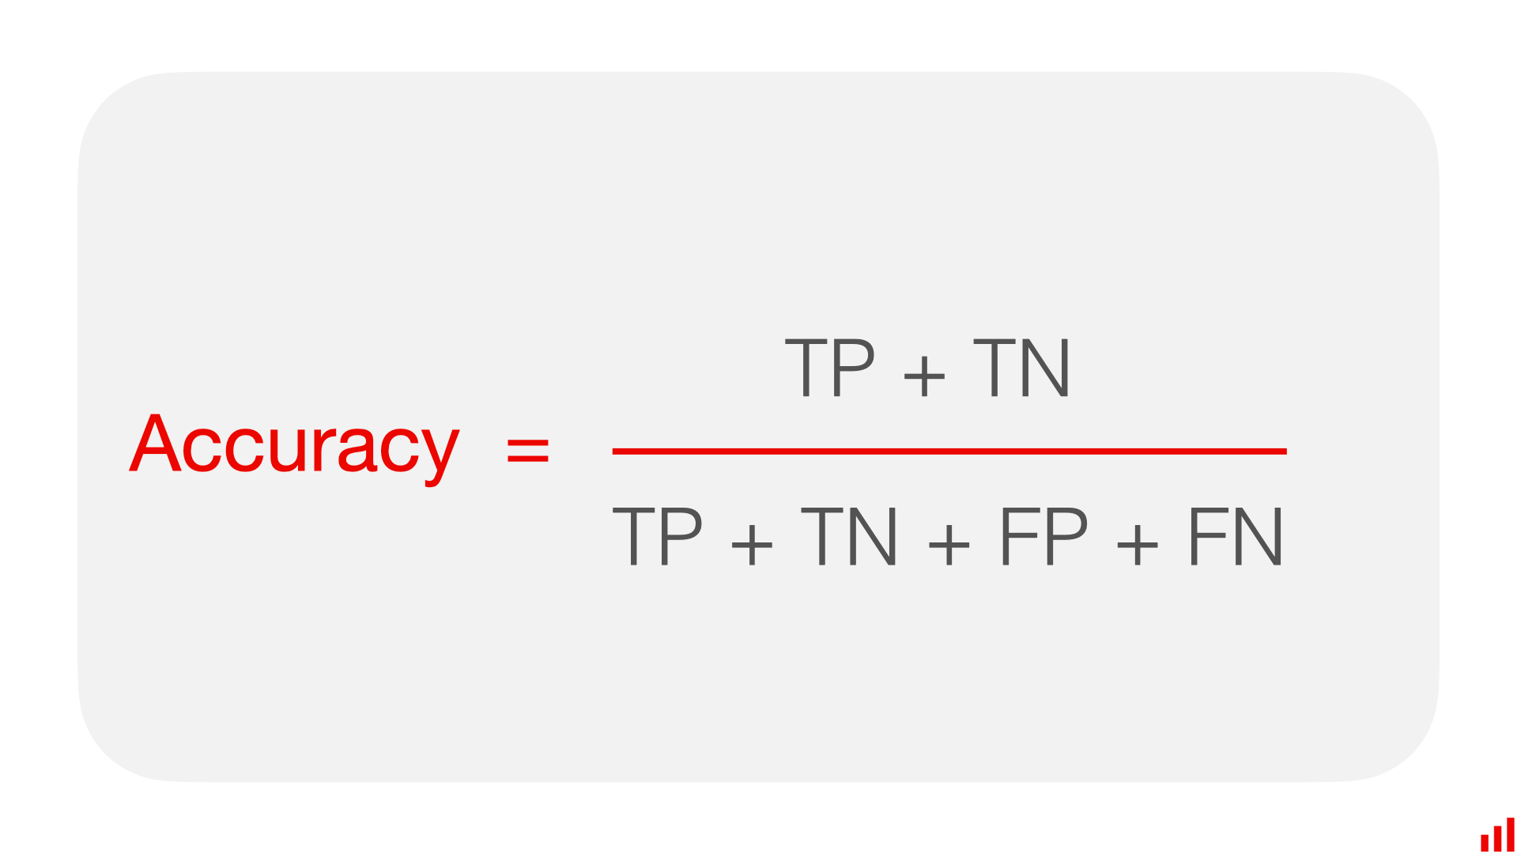
Evaluation Metrics
Accuracy
When to use:
When classes are balanced.
Why it’s useful:
Gives overall correctness of the model.
Limitation:
Misleading in imbalanced datasets. E.g., predicting 100% "no disease" in 99% healthy population gives 99% accuracy — but it's useless.

Slide 9
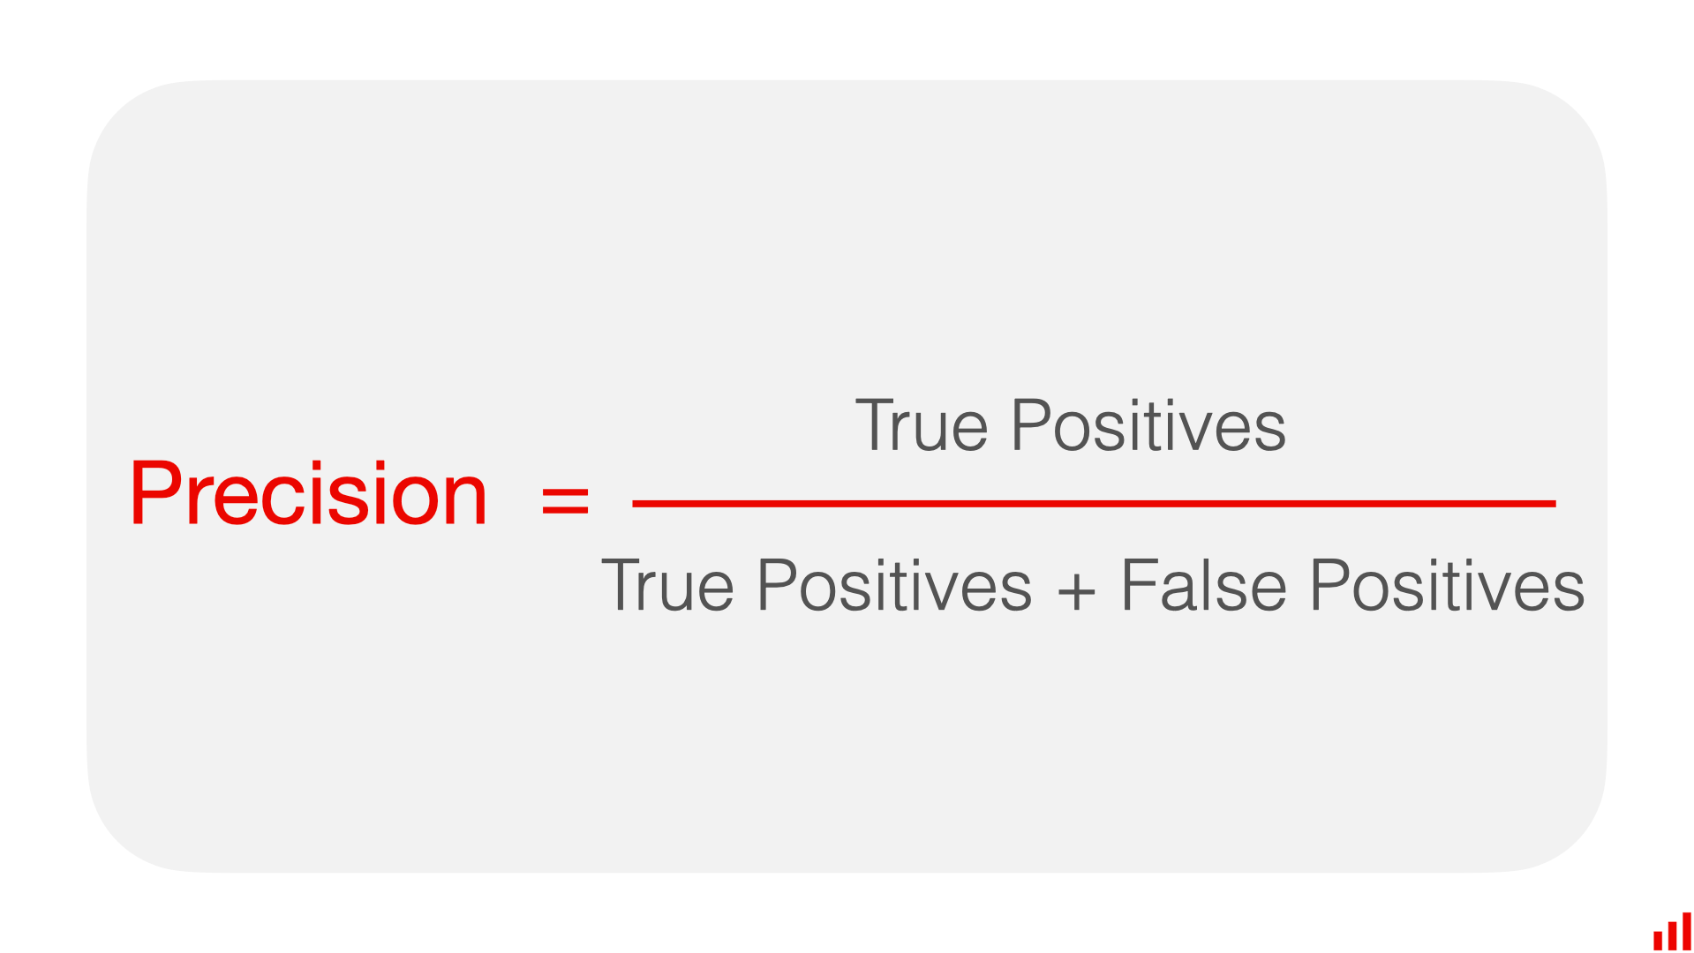
Evaluation Metrics
Precision
Why it’s useful:
Out of all positive predictions, how many were actually correct.
High precision = few false positives.
Important when false positives are costly.
Example: Predicting spam emails (you don’t want to mark genuine emails as spam).
Limitation:
In imbalanced datasets, where positives are rare, a model might get high precision by predicting very few positives. But this doesn't mean it's useful — because it might fail to detect most positive cases.
It doesn't care about False Negatives (FN) — i.e., how many actual positives the model missed.

Slide 10
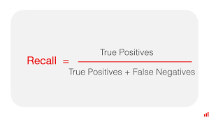
Evaluation Metrics
Recall
Why it’s useful:
Out of all actual positives, how many were correctly predicted.
High recall = few false negatives.
Important when missing a positive case is costly.
Example: Disease detection (missing a sick patient is dangerous).
Limitation:
Recall only considers True Positives (TP) and False Negatives (FN).
It does not account for False Positives (FP) — i.e., how many incorrect positive predictions the model makes.

Slide 11
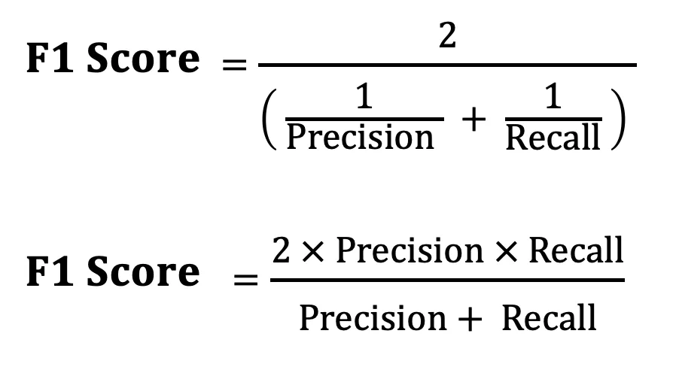
Evaluation Metrics
F1-score
Why it’s useful:
You can’t always maximize both. Often increasing precision reduces recall, and vice versa.
Precision vs Recall Trade-off
Harmonic Mean
The harmonic mean is always less than or equal to the arithmetic mean. It gives more weight to the smaller value.
This means: if either precision or recall is very low, the F1 score will also be low.

Slide 12
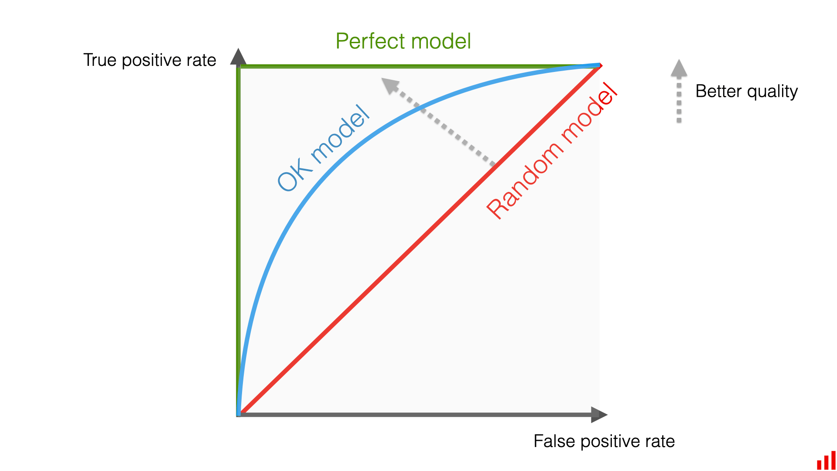
Evaluation Metrics
ROC Curve & AUC
Why it’s useful:
ROC Curve
Plots True Positive Rate (Recall / Sensitivity) vs False Positive Rate (Specificity) at different thresholds.
Shows how model performance changes with classification threshold.
A curve closer to top-left indicates better performance.
AUC
Measures the area under the ROC curve.
Ranges from 0 to 1. Closer to 1 = better model.
AUC = 0.5: No better than random.
AUC = 1.0: Perfect classifier.

Slide 13
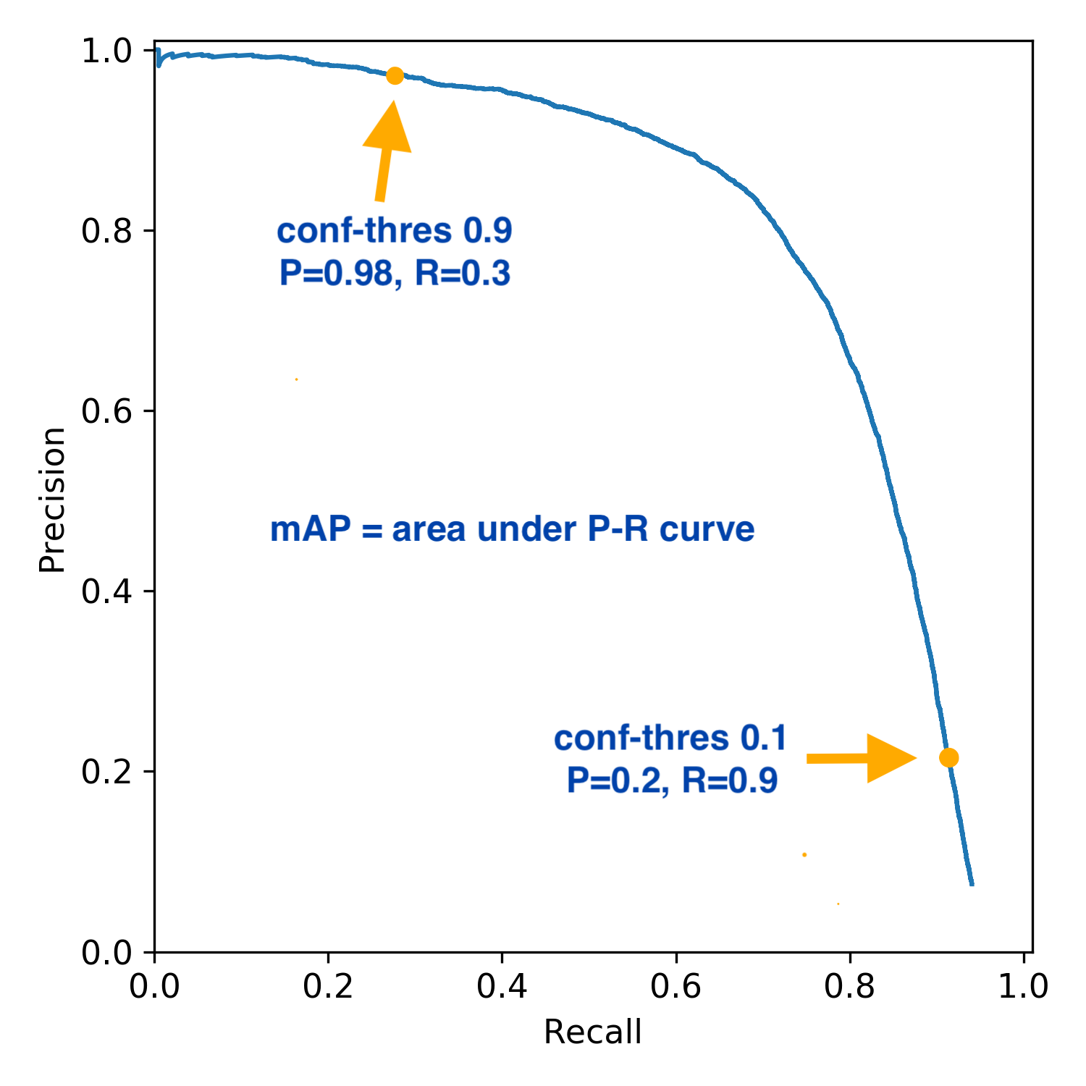
Evaluation Metrics
Precision - Recall Curve
Why it’s useful:
PR Curve
A Precision-Recall Curve is a plot that shows the tradeoff between Precision (y-axis) and Recall (x-axis).
Shows how model performance changes with classification threshold.
A curve closer to top-right indicates better performance.
The PR curve is especially useful when the positive class is rare.
The PR curve focuses only on positive predictions, making it more informative in imbalanced scenarios.
AU-PRC
Measures the area under the ROC curve.
Ranges from 0 to 1. Closer to 1 = better model.
AU-PRC = 0.5: No better than random.
AU-PRC = 1.0: Perfect classifier.

Slide 14
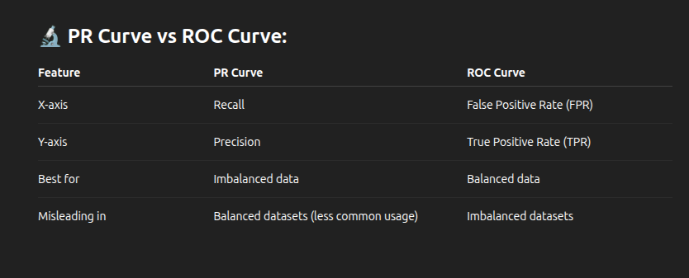
Evaluation Metrics

Slide 15
Data Scaling
Why is Data Scaling Important?
Machine Learning algorithms often rely on distance, gradient, or regularization. If features have very different scales:
One feature may dominate others (e.g., age in years vs. salary in thousands).
Algorithms may take longer to converge.
Some algorithms may perform poorly or make wrong assumptions.
Example: K-Nearest Neighbors (KNN), Logistic Regression, SVM, and Gradient Descent-based models are very sensitive to feature scale.

Slide 16
Data Scaling
Why is Data Scaling Important?
1️⃣ "One feature may dominate others"
🔔 Problem: When features are on very different scales, larger-scale features can overpower smaller ones.
💡 Example: Suppose you're building a model to predict if someone will buy a product based on:
Age (e.g., 20–70 years), Annual Salary (e.g., $20,000–$200,000)
If you don’t scale, the salary values (in thousands) dominate the age values:
Unscaled Input Example: Age = 30, Salary = 150000
The model might "think" salary is much more important simply because 150000 > 30 — even if age is more predictive.
⚠️ Affected Algorithms:
KNN: Uses distance - larger feature dominates distance.
SVM, Logistic Regression: May give higher weight to bigger-scaled features.

Slide 17
Data Scaling
Why is Data Scaling Important?
2️⃣ "Algorithms may take longer to converge"
🔔 Problem: Some models (like logistic regression or neural networks) use gradient descent to optimize. If features are on different scales, the cost function surface becomes elongated/warped, making optimization slower.
💡 Intuition: Think of finding the bottom of a bowl (minimum). If the bowl is stretched in one direction, it’s harder for the algorithm to find the shortest path. It may zig-zag a lot before converging.
⚠️ Affected Algorithms:
Linear Regression
Logistic Regression
Neural Networks
✅ Scaling helps:
Smooth, symmetric optimization landscape
Faster and more stable training

Slide 18
Data Scaling
Why is Data Scaling Important?
3️⃣ "Some algorithms may perform poorly or make wrong assumptions"
🔔 Problem: Some algorithms (like PCA, SVM, or regularized regression) assume features are on the same scale. If not, they give unfair importance to features with larger values.
💡 Example:
PCA (Principal Component Analysis):
Finds directions of max variance.
If salary has larger magnitude, PCA will mostly capture salary variance, ignoring age even if it's important.
Regularization (L1/L2 penalty):
Penalizes large coefficients.
If a feature has larger scale, its coefficient may be smaller - but not because it's less important.
⚠️ Affected Algorithms:
PCA
SVM
Ridge, Lasso Regression

Slide 19
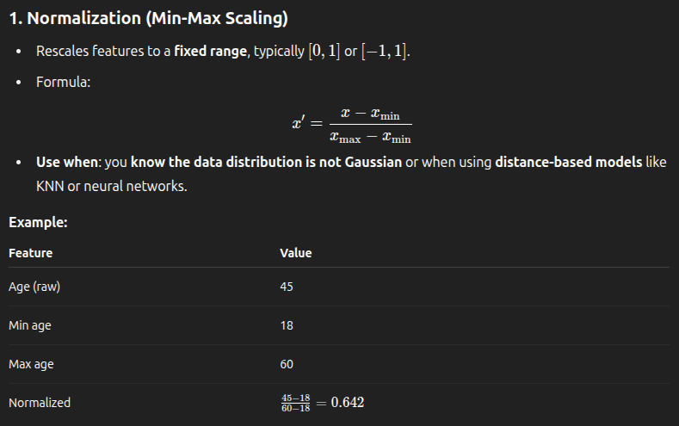
Data Scaling
Types of Data Scaling Techniques

Slide 20
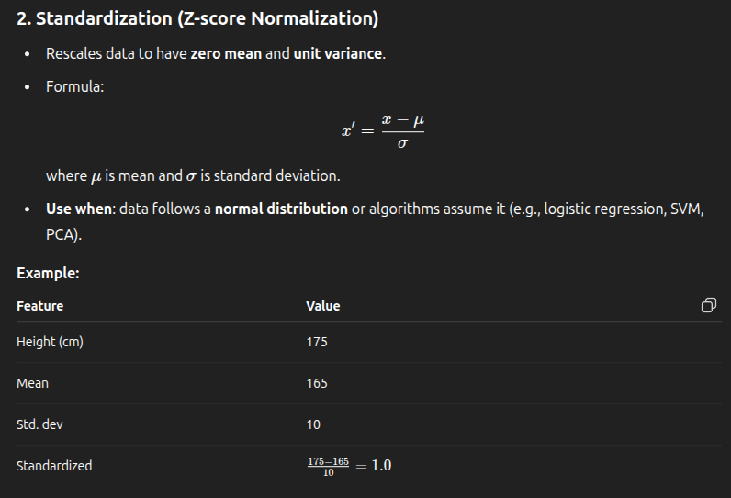
Data Scaling
Types of Data Scaling Techniques

